Slide 1

Agile Software Development
CH01: Introduction to Agile Principles
Course Instructor: AMIR IMAM

Slide 2
Content
Software Development Models
History and context of Agile
Agile Software Development
The Agile Manifesto
              Values
              Principles
              Business Agility
              Agile Frameworks

Slide 3
AGILE ?
AI ML DL
Prototyping
SCRUM
BRS
Risk
FS
Functional
STLC
API
Automation
OOP
Database
RTM
Customer vs Client vs User
SRS
FDS
Data Science
V-Model
UML
Test Case
Quality Assurance
SaaS PaaS IaaS
Business Analyst
Scope
Safety Vs Security
REVIEWS
Model Standard Best Practices Framework Methodology Process
Metric & Measurements
Product Owner
Project Plan
KANBAN
ERP
WATERFALL
Performance
Costing & Estimations
TDD
SYSTEM vs SOFTWARE
Release Notes
Scrum Master
JIRA TRELLO Azure DevOps
Testing
N-Tier Architecture
SDLC
User Story
Non-Functional
DevOps

Slide 4
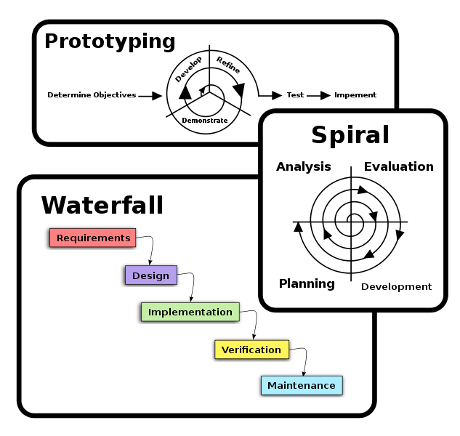
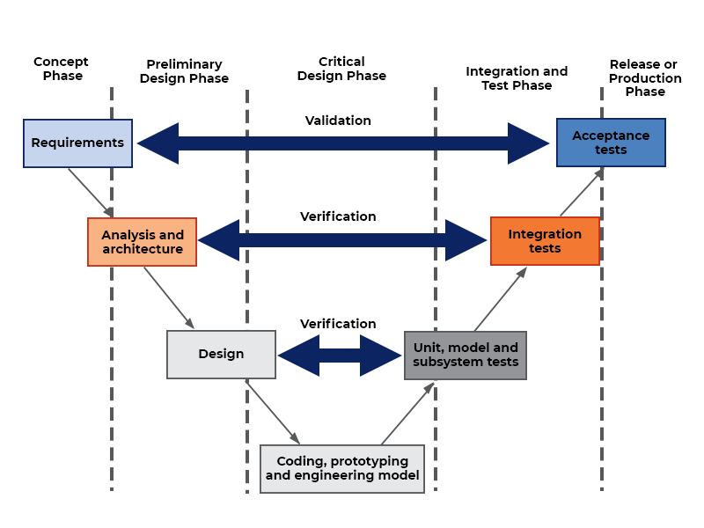
Software Development Models

Slide 5
Waterfall
Step by Step
Sequential Model: Work in a sequence
Following top-down approach, Just like its name suggest Waterfall
Next step won’t start, unless current step got completed
Very rigid
Changes couldn't be brought easily when required
Emphasis on following a processes and Tools
Extensive Documentation needed
Customer won’t get to see the product unless the time of UAT
Extensive Planning

Slide 6
When to use Waterfall
Where to use waterfall?
When the scope is fixed
  No changes are required
  Because changes are costly
  Need Time
When Customer involvement is least
Project is Relatively simple and you have done it many times before
Customer know well in advanced what they want

Slide 7
What is AGILE?
AGILE?
Dictionary: “Able to move quickly and easily”
example: He is Agile like a Cheetah!
Agility means quickly adapting to changing situations
Being Flexible
Agile doesn’t make decisions for you
It gives you a platform to make your own decisions and improve the process

Slide 8



What Agile is NOT?
METHOD
FRAMEWORK
PROCESS

Slide 9
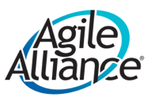
What is AGILE?
AGILE?
Agile is the ability to create and respond to change. It is a way of dealing with, and ultimately succeeding in, an uncertain and turbulent environment.

Slide 10
What is AGILE?
AGILE?
Agile is a mindset informed by the Agile Manifesto’s values and principles. Those values and principles provide guidance on how to create and respond to change and how to deal with uncertainty

Slide 11
What is AGILE?
AGILE?
Popularized in the 2001
Manifesto for Agile Software Development,
these values and principles were derived from and underpin a broad range of software development frameworks, including Scrum and Kanban etc.

Slide 12
What is AGILE?
AGILE?
Agile Software Development practices include requirements discovery and solutions improvement through the collaborative effort of
Self-Organizing and Cross-Functional teams with their Customers / End Users

Slide 13
What is AGILE?
AGILE?
Methodology
A specific way of developing software
A list of instructions, or certification
A framework or process

Slide 14
What Agile is NOT?
A Methodology
A Framework
A Process

Slide 15
AGILE MANISFESTO
In 2001, 17 Peoples list down a manifesto they call
“Manifesto for Agile Software Development”
Manifesto Means → Declaration, Announcement, Publication
Agile Manifesto consists of 04 Core Values
Agile Manifesto Consists of 12 Principles
They created an Alliance called Agile Alliance

Slide 16
Framework vs Methodology
A standard is a good or best Practices
A framework is a loose but incomplete structure which leaves room for other practices and tools to be included but provides much of the process required…
A methodology is set of principles, tools and practices which can be used to guide processes to achieve a particular goal.

Slide 17
Methodology & Framework
A methodology is the set of conventions that a team agrees to follow.
That means that each team will have its own methodology, which will be different in either small or large ways from every other team’s methodology.
Alistair Cockburn
So Agile methodologies are the conventions that a team chooses to follow in a way that follows Agile values and principles.
“Wait,” you’re probably saying, “I thought Scrum and XP were Agile methodologies.” Alistair applied the term framework to those concepts.
They certainly were born from a single team’s methodology, but they became frameworks when they were generalized to be used by other team. Those frameworks help inform where a team starts with their methodology, but they shouldn’t be the team’s methodology. The team will always need to adapt its use of a framework to fit properly in its context.

Slide 18

A framework is a loose but incomplete structure which leaves room for other practices and tools to be included but provides much of the process required…
?

Slide 19
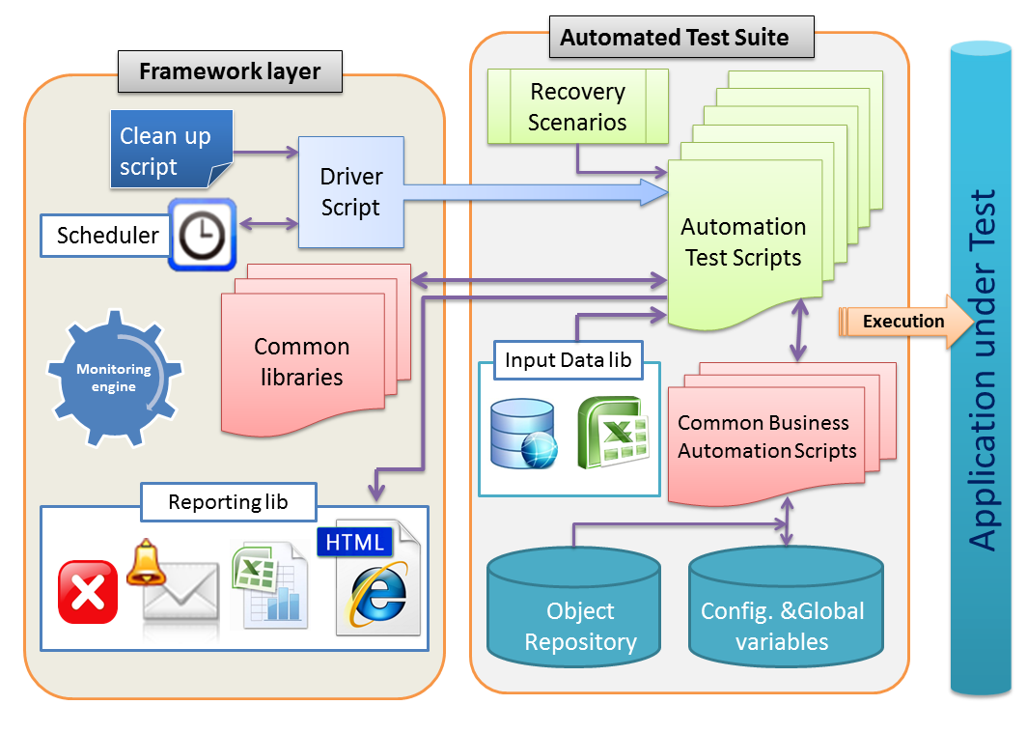
?

Slide 20
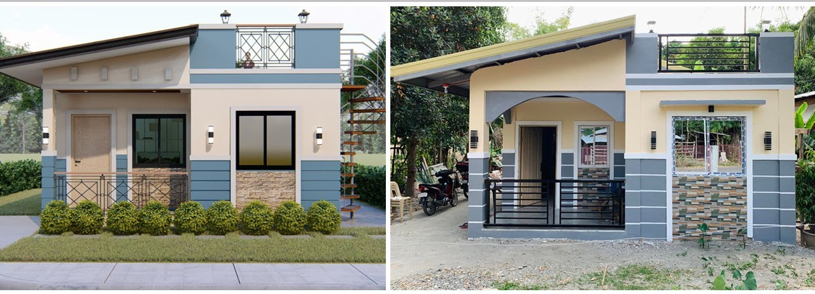
?
A model is an informative representation of an object or system, a simplifying image of reality.
It is a complete solution

Slide 21

?

Slide 22


AGILE?
IS A SET OF
Values
Principles

Slide 23
VALUE ?

Slide 24
Agile is…
So, Agile is a Defined in the “Agile Manifesto” as set of Values and Principles that help develop a better software.
Agile is a set of “Beliefs” that team can use to make “Decisions” and use “Practices” to Develop a software
Agile Tells us Best Practices and its up to us to implement them

Slide 25
When to Use Agile?
When there is No Clear Definition of the Final Product
When changes are needed in scope frequently
You have to accommodate changes rapidly
Customer Involvement is most
Customer feedback is needed at various stages and is the most important
Value has to be delivered early

Slide 26
What is AGILE?
AGILE?
Agile Software Development is a term used to describe approaches to software development emphasizing incremental delivery, team collaboration, continual planning, and continual learning, instead of trying to deliver it all at once near the end.

Slide 27
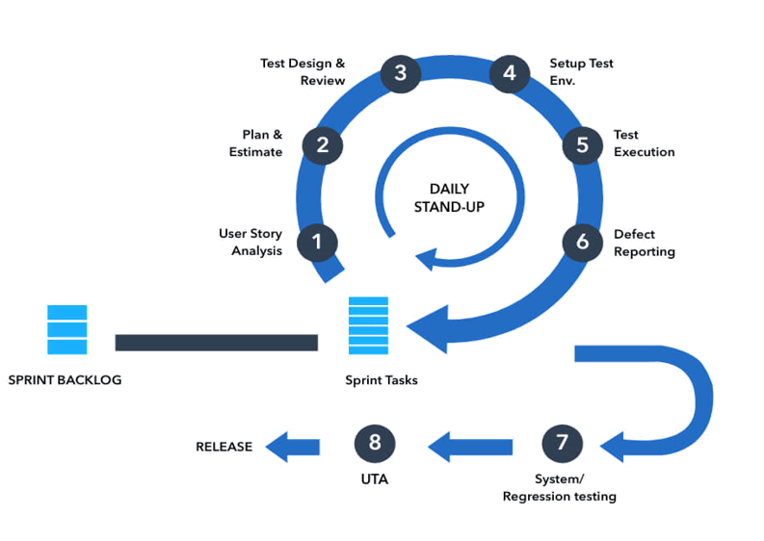
What is AGILE?

Slide 28
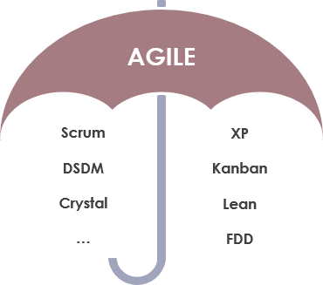
What is AGILE?
Agile software development is more than frameworks such as Scrum, Extreme Programming, or Feature-Driven Development (FDD).
Agile software development is more than practices such as pair programming, test-driven development, stand-ups, planning sessions, and sprints.

Slide 29
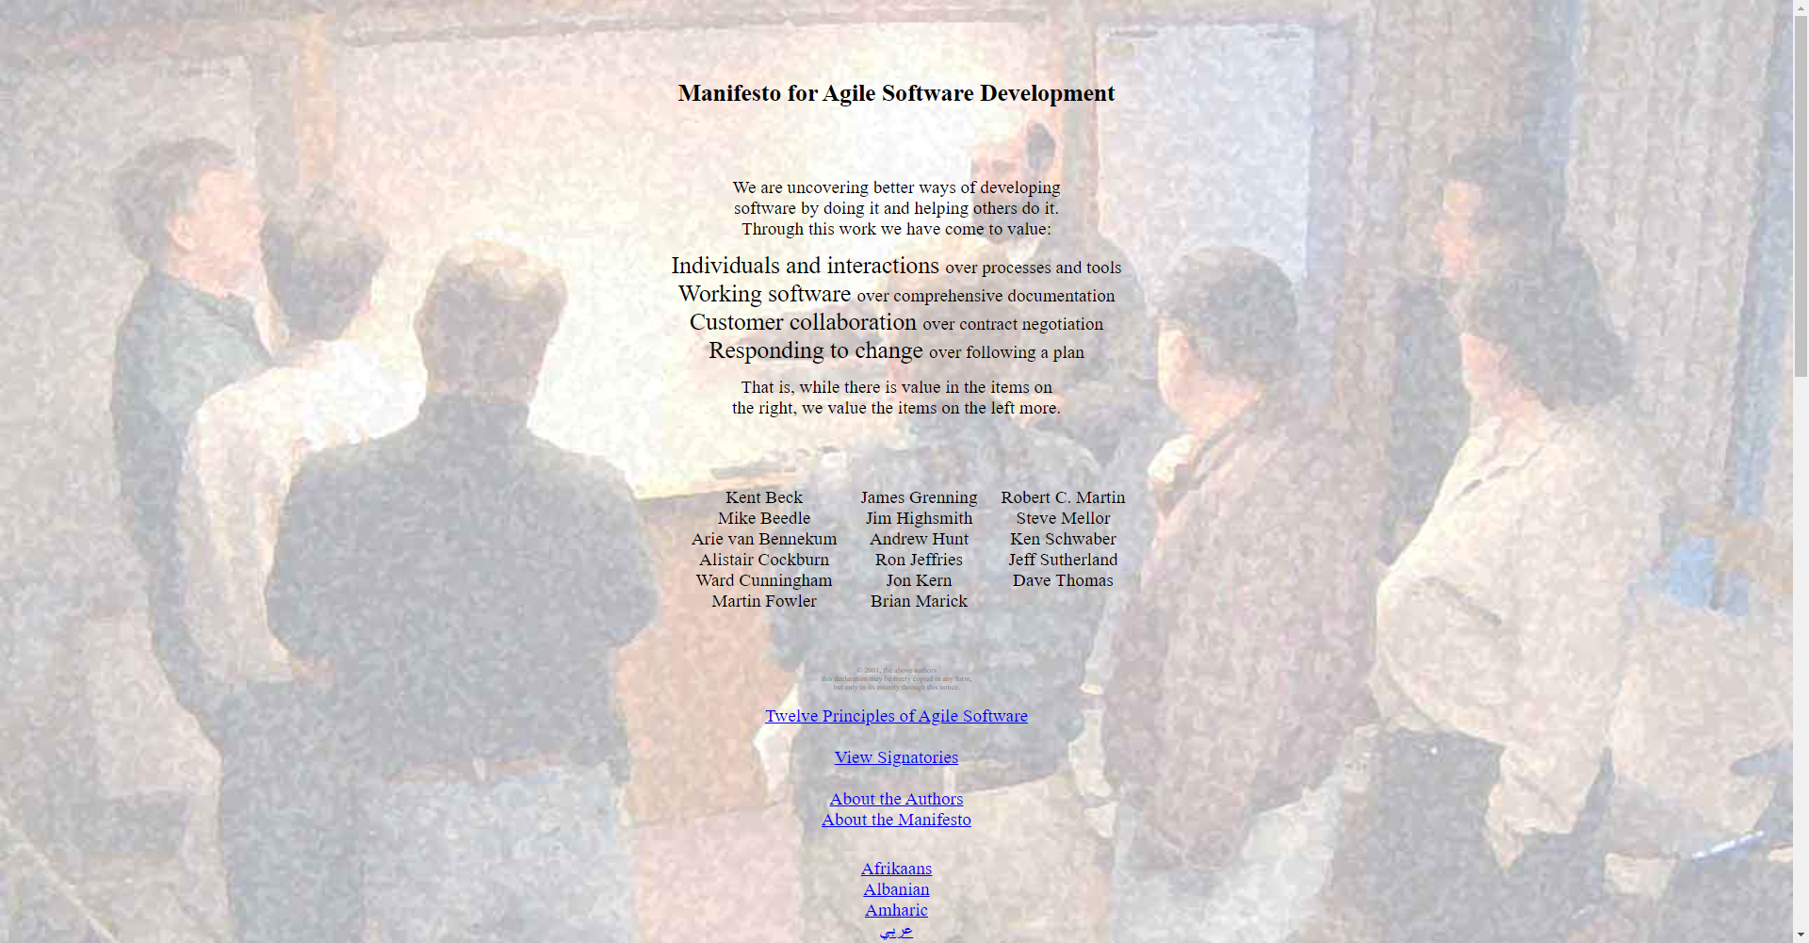
https://agilemanifesto.org/

Slide 30
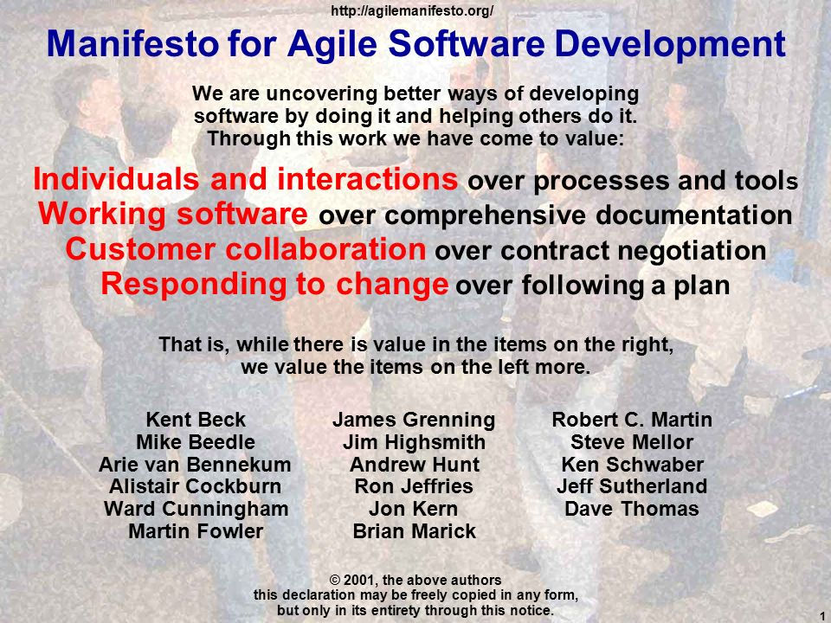

Slide 31
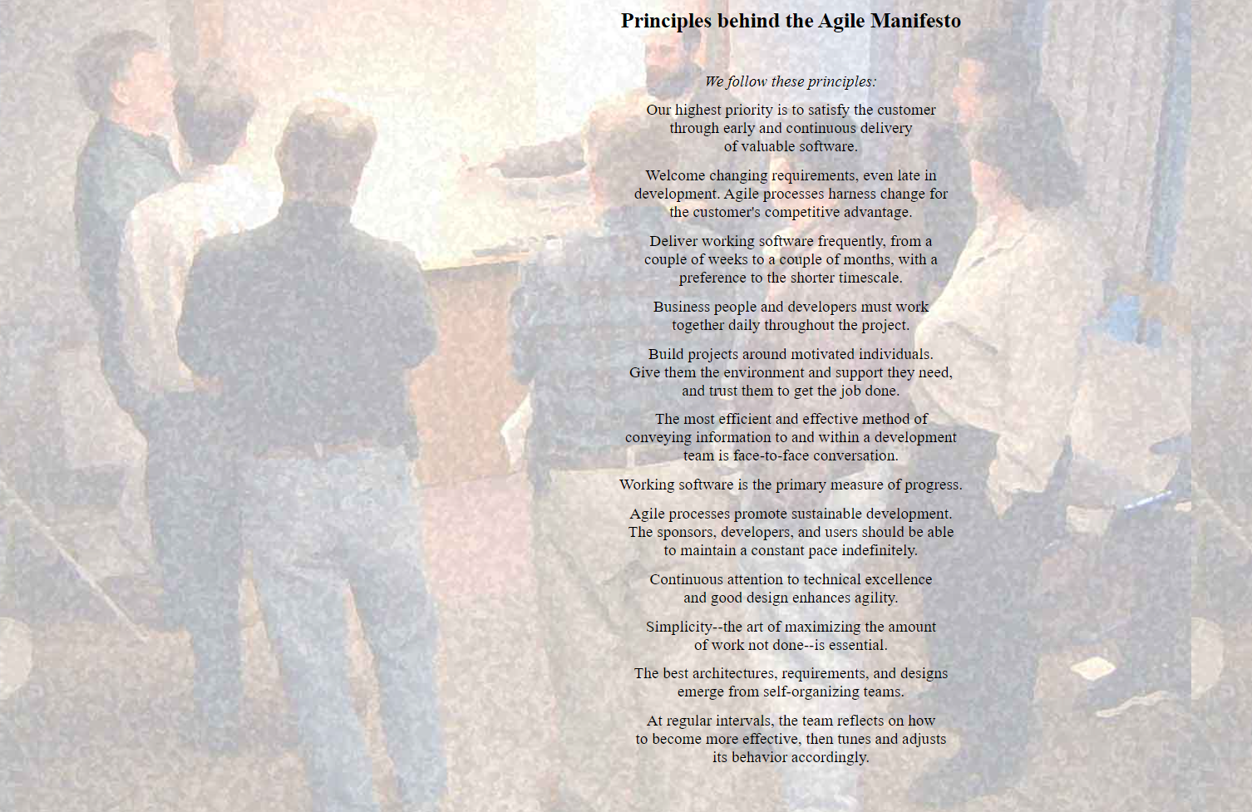
https://agilemanifesto.org/

Slide 32
Agile Alliance
Who is the Agile Alliance?
The original signatories to the Agile Manifesto were a group of 17 developers, scientists, programmers, and authors who came together to find a solution to the perceived ills of the software development industry.
Agile philosophy pre-dated the Agile Manifesto, and the group included a number of inventors and creators of earlier agile frameworks. Kent Back of extreme programming, Jim Highsmith of adaptive software development, and Jeff Sutherland of Scrum, to name a few.
The full list of signatories is:
Kent Beck, Mike Beedle, Arie van Bennekum, Alistair Cockburn, Ward Cunningham, Martin Fowler, James Grenning, Jim Highsmith, Andrew Hunt, Ron Jeffries, Jon Kern, Brian Marick, Robert C. Martin, Steve Mellor, Ken Schwaber, Jeff Sutherland, and Dave Thomas.

Slide 33
ACTIVITY ?
Details:
To create a picturesque landscape that includes mountains, water streams, house(s), trees, the sun, clouds, eagles, etc. Use simple and creative representations to convey the elements of the scene without getting into too much detail.

Slide 34


Slide 35


Slide 36


Slide 37





































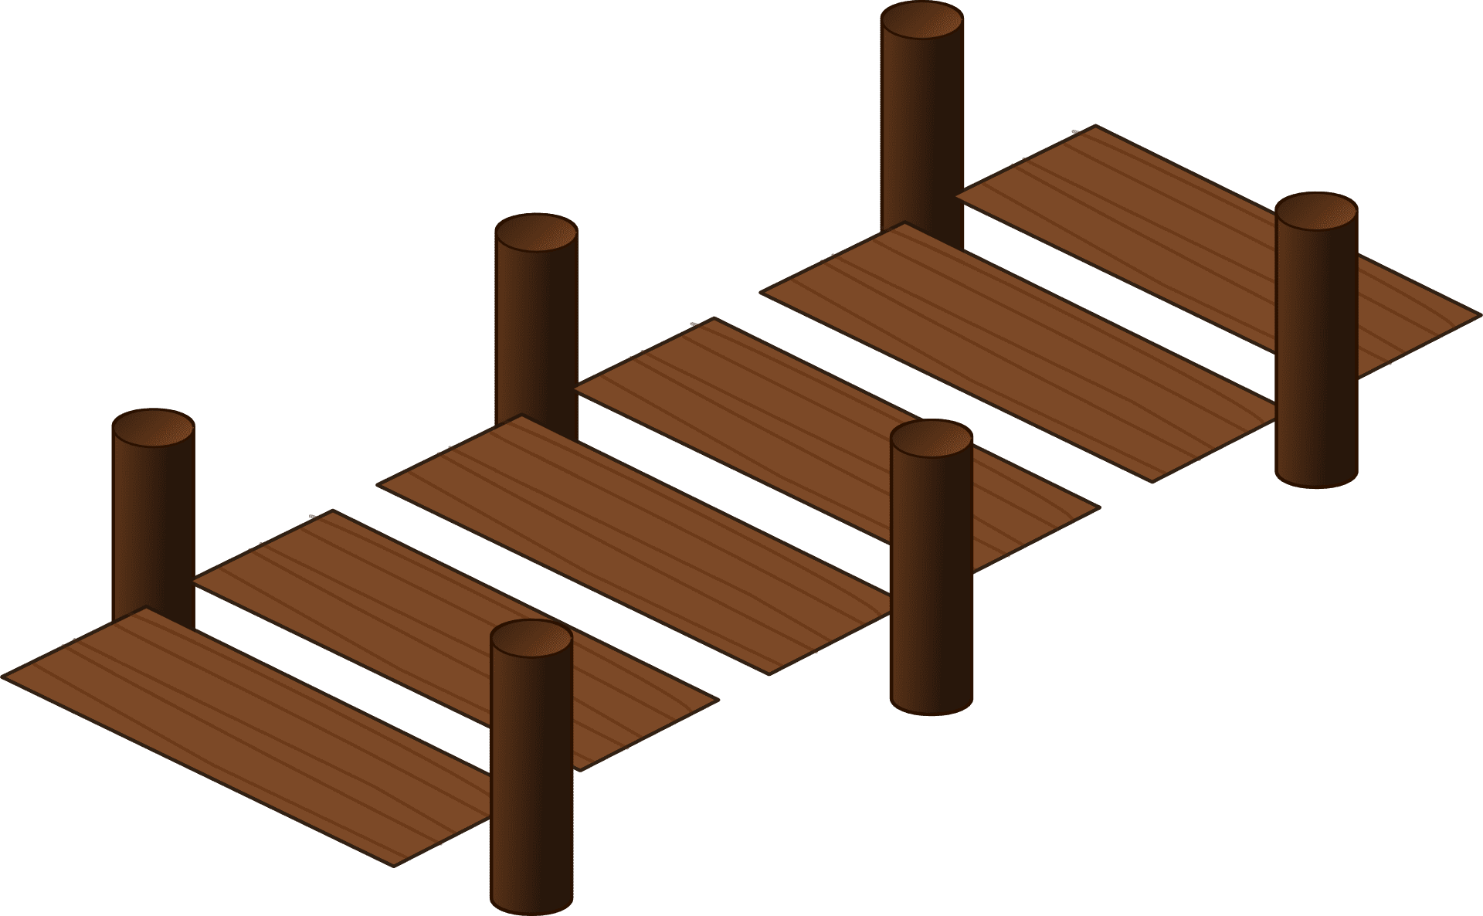


















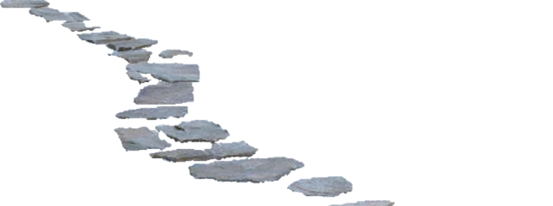








Slide 38


Slide 39









Slide 40
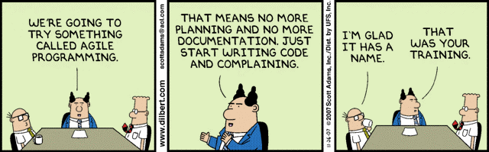
Agile Misconceptions

Slide 41
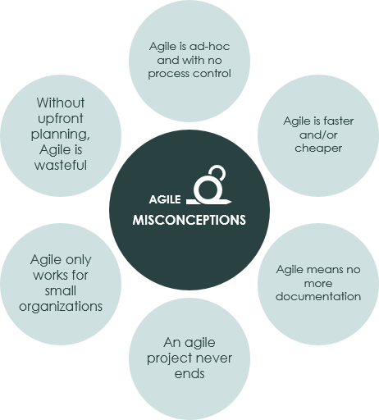
Agile Misconceptions

Slide 42
Agile Misconceptions
Agile is ad hoc, with no process control: Agile provides a range of formal processes, and methods, to inform work processes, customer engagement and management models. Conversely, Agile isn’t about blindly following the prescribed ‘agile’ methods and processes. Agile is about using your common sense to apply processes, as determined by the current situation, and shaped by the agile philosophy.
Agile is faster and/or cheaper: Agile isn’t significantly faster, or cheaper, than alternative frameworks. Put another way, in most cases you can’t get significantly more effort out of your Teams by moving to an agile approach. While there is an overall efficiency gain when utilizing agile methods, well-managed Agile and non-Agile Teams will deliver products and services in approximately the same time and effort.
Agile mean no more documentation: Agile is not an excuse to avoid appropriate planning or writing documentation. It is an on-demand, or Just-In-Time, approach that encourages continuous planning and documentation, but only when needed for specific Customer Requirements. This allows Customers and Teams to determine if the planning, or document, adds value to the process or product. It creates an opportunity to emphasize valuable documents, and eliminate anything that isn’t useful.
An Agile project never ends: While this may be true in some situations, the benefit of Agile is that work will continue while the Customer continues to gain business value, and that value is worth more than the cost of developing it. Most projects, in any industry, have a point of diminishing returns. This is the ideal time for an agile project to end.
Agile only works for small organizations: Agile works for projects, teams and organizations of any size, not just small projects. That is not to say that it will work for all organizations, but size is rarely a factor. Large and complex projects and organizations are often excellent candidates for Agile transformation, where it is difficult, or impossible, to know all your Customer’s Requirements in advance.
Without upfront planning, Agile is wasteful: This assumes that your Customer knows the detail of all of their Requirements in advance. If this is true, then by all means, undertake comprehensive upfront planning. However, in reality this is rare, and usually leads to the greater ‘waste’ of having undertaken design and development work that was ultimately unnecessary. Agile Business Management encourages minimal upfront planning, ensuring everyone is working towards the same goal, and reduces the risk of miscommunication.

Slide 43
Agile Values

Slide 44
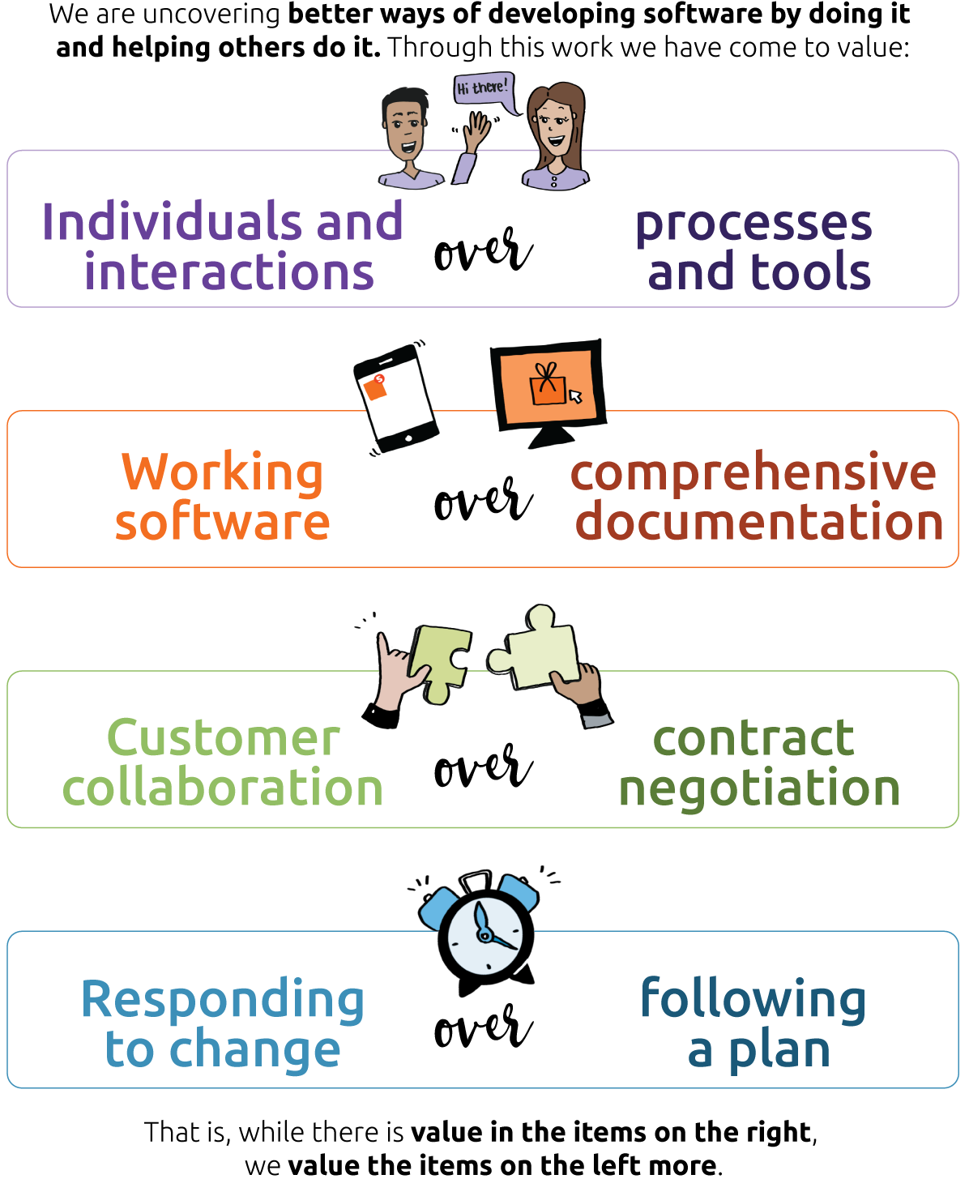
Agile Manifesto

Slide 45

Agile Manifesto – VALUES
Individuals and interactions over process and tools:
The first value of the Agile Manifesto might be the most ahead of its time. The authors knew that people mattered and collaboration was essential.
Agile places more importance on people over processes and even tools. People respond to business needs and drive the development process.
Notes:
4, 5 ,6 ,8, 11 12
In the real world, I’ve seen this play out in cross-functional squads made up of product, engineering, design, quality assurance, data analytics, and even marketing stakeholders — working day after day, in a single team, on a customer problem.

Slide 46

Agile Manifesto – VALUES
Working software over comprehensive documentation:
“Documentation is good, but delivering working software is even more important.”
Documentation takes time. Each piece of documentation, from technical requirements to testing plans and other specifications, requires approval. This delays development.
Agile is about streamlining, not eliminating documentation. While documentation has its value, in the agile mindset, it is software that is paramount.
Getting a minimum viable product (MVP) out now is better than getting a “perfect” product out much later. Of course, a “working” product is not the end goal, but it is required for delivering value to customers and businesses. If we’re not shipping, then what are we actually accomplishing?
Notes:
While the first Agile Manifesto value is probably the most foundational of the four, the second value might be the most controversial today. The emphasis on “working software” often alarms modern tech professionals. What is so great about software that only “works?”
I have a friend who is a product manager at a large company. While developing their product, they spent up to a year digging into user research and discussing customer insights without shipping anything to the customer. In the end, they produced a small, insignificant feature that didn’t meet any real customer need.
So in cases like these, everyone wants to be a philosopher and empathize with customers, but no one can actually deliver.
Getting a minimum viable product (MVP) out now is better than getting a “perfect” product out much later. Of course, a “working” product is not the end goal, but it is required for delivering value to customers and businesses. If we’re not shipping, then what are we actually accomplishing?
Comprehensive documentation is good, according to the Agile Manifesto. This is how the even over statements work. For example, the second value could be rephrased as, “Documentation is good, but delivering working software is even more important.” A product with no documentation is preferable to having documentation and no product.

Slide 47

Agile Manifesto – VALUES
Customer collaboration over contract negotiation:
Customers and product managers must work out the details of delivery, but rather than negotiate this process, agile champions collaboration.
For example, in traditional project management methodologies, customers negotiate the requirements for the product in detail—before work starts. However, agile includes the customer throughout the life cycle of the project for their continual feedback.

Slide 48
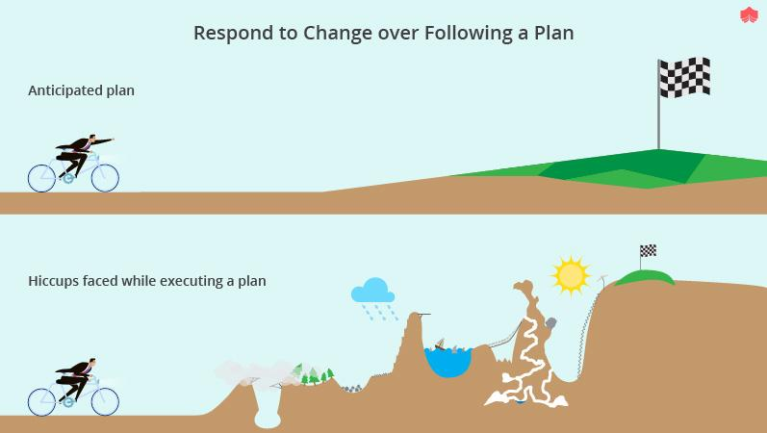
Agile Manifesto – VALUES
Responding to changes over following a plan: While change happens, it’s to be avoided as much as possible when working with a traditional project management methodology. However, agile works in short iterations called sprints, because their brevity allows for changes and even embraces them as a way to improve a project and add value.

Slide 49
Agile Principles

Slide 50
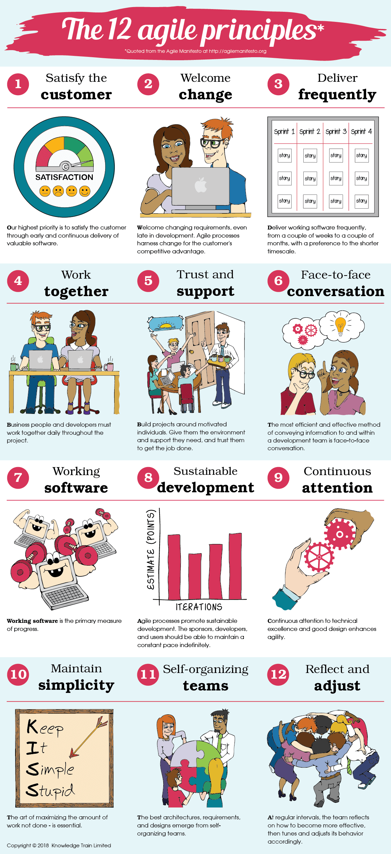
12 Agile Principles

Slide 51
12 Agile Principles

Slide 52
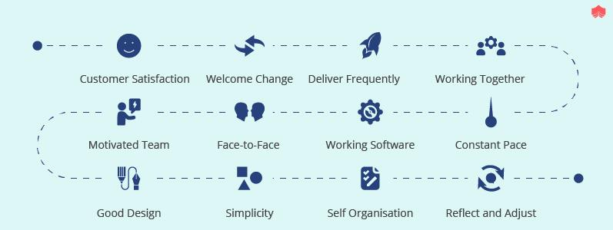
12 Agile Principles

Slide 53
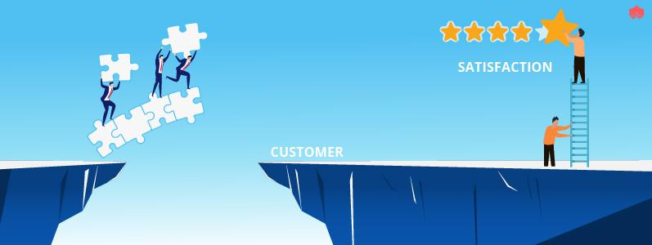
Agile Manifesto Principles
1. Customer Satisfaction through Early and Continuous Software Delivery:
What does it mean?
As agile professionals, we believe in relieving customer pain by delivering valuable products and features quickly and regularly.
Why?
We can get feedback faster to improve and increase value to customers — and because we know that we never get it entirely right the first time.
How to apply Agile Principle No. 1
Focus on customers’ problems
Build minimum viable products
Operate with minimum valuable processes
Foster a culture of learning and iteration in your team

Slide 54

Agile Manifesto Principles
2. Accommodate Changing Requirements Throughout the Development Process:
Welcome changing requirements, even late in development. Agile processes harness change for the customer’s competitive advantage.
What does it mean?
Embrace uncertainty. The environment is constantly changing, and change is something we can use to our advantage. To be competitive, not only should we anticipate change, but we should welcome it.
How to apply Agile Principle No. 2
Update sprint goals mid-sprint more frequently
Set the tone for others by not being surprised when needs change
Celebrate when your team pivots
Use continuous discovery habits to stay in tune with customer problems and the market

Slide 55
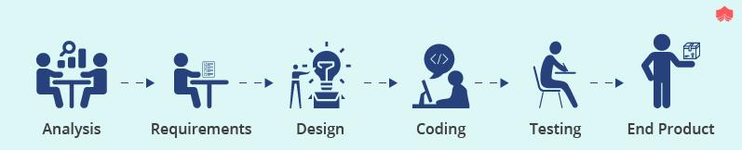
Agile Manifesto Principles
3. Deliver working software frequently
Deliver working software frequently, from a couple of weeks to a couple of months, with a preference for the shorter timescale
What does it mean?
Take baby steps. There are multiple advantages to releasing more minor product updates more frequently. Shipping smaller increments regularly and being able to deploy quickly mitigates risk. Additionally, you can add value to the business by delivering more frequently and learning faster.
How to apply Agile Principle No. 3
Test how quickly your team can get a change live by making small changes (e.g., a comment in some code). This will help you gauge where you are and optimize your ability to respond to change
Break up stories into smaller pieces. Need some inspiration? Consider what it might look like to only have one-point stories or only stories that can be delivered within a day

Slide 56
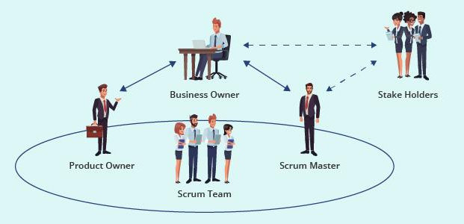
Agile Manifesto Principles
4. Work together daily
Business people and developers must work together daily throughout the project.
What does it mean?
Who is included in “business people?” I interpret this phrase to refer to anyone not on the tech teams — e.g., product, design, marketing stakeholders, etc. Of course, it depends on the organization, project, or outcome you hope to achieve.
No matter who is involved, transparency and collaboration should be day-to-day normalcy.
How to apply Agile Principle No. 4
Consider inviting other stakeholders to team meetings while managing expectations on roles and responsibilities as necessary
Make planning and roadmap artifacts more accessible so others can follow along with progress and ask questions or provide feedback
Create a visual of the team but include colleagues who might not technically be on the same team according to the official org chart
Use an open Slack channel (or chat tool of choice) instead of keeping it private

Slide 57

Agile Manifesto Principles
5. Support, Trust, and Motivate the people involved:
Build projects around motivated individuals. Give them the environment and support they need, and trust them to get the job done.
What does it mean?
There are a lot of words packed in the fifth agile principle: motivation, environment, support, trust — with individual people at the center of it all.
A supportive environment will mean different things to different people. It comes down to knowing your team and how to communicate with and support the individuals within it.
How to apply Agile Principle No. 5
You might find this principle the most challenging because it cannot be isolated to a specific level in an organization. For example, as a product manager, your hands might be tied in many ways.
That said, some things are always within your control. To improve the work environment as a manager, you can:
Make work fun (whatever that means to you and your team)
Treat people as individuals and get to know them personally
Celebrate wins, big and small
Establish a compelling vision for your product or program

Slide 58

Agile Manifesto Principles
6. Enable Face-to-Face Interactions
The most efficient and effective method of conveying information to and within a development team is face-to-face conversation.
What does it mean?
Video conferencing tools have made “face-to-face” conversations more effortless than ever, but they still don’t entirely replace in-person interaction.
At the same time, there are many advantages to remote work, so the takeaway isn’t that teams must be collocated, either.
How to apply Agile Principle No. 6
Turn your video on
Meet in person from time to time
Don’t be shy to jump on a quick call to hash something out in real time (using Slack’s huddle feature, for example)
When using text, sprinkle in emoji reactions to avoid any confusion about your tone

Slide 59

Agile Manifesto Principles
7. Working Software is the Primary Measure of Progress
Working Software is the primary measure of progress
What does it mean?
Basically, it means to cut through the BS. The seventh agile principle stipulates that working software is the “primary measure of progress,” but some folks get alarmed because they read “only measure of progress” instead.
This principle can feel out of touch in a world where we value customer problem statements, fancy visual frameworks, user research, market research, analytics, and anthropology.
While these factors are important, what good are they if we aren’t getting any tools out into the wild to help customers in real life?
How to apply Agile Principle No. 7
Document and plan as you go
Prioritize building things that will help customers now
Double down on agile principle No. 1
Apply healthy pressure to teams by asking, “Have we actually helped customers lately?”

Slide 60

Agile Manifesto Principles
8. Agile Processes to Support a Consistent Development Pace
Agile processes promote sustainable development. The sponsors, developers, and users should be able to maintain a constant pace indefinitely.
What does it mean?
Agility means that burnouts, late nights, and last-minute emergencies should be rare. The cross-functional team should plan to move at a sustainable rate. This can be supported by adopting the other agile principles, as well.any tools out into the wild to help customers in real life?
How to apply Agile Principle No. 8
A common mistake people make when reading the eighth principle is to misinterpret the word “pace.” Most often, “maintaining a constant pace” means the team should slow down, not speed up. Plan ahead and put systems in place that make it normal to react to change.

Slide 61

Agile Manifesto Principles
9. Pay continuous attention to technical excellence
Continuous attention to technical excellence and good design enhances agility.
What does it mean?
You should take pride in your craftsmanship. Vince Lombardi, famed NFL head coach for whom the Super Bowl trophy is named, once said, “Perfection is not attainable, but if we chase perfection, we can catch excellence.”
The ninth agile principle doesn’t aim for perfection; we should acknowledge that excellence in the tech world is a rapidly moving target and to hit it requires “continuous attention.”
How to apply Agile Principle No. 9
Host lunch-and-learns and “brown bag” educational opportunities
Build in time to incorporate tech debt into sprints
Foster a culture in which team members are encouraged to maintain quality and sustainable implementations for longer-term agility

Slide 62
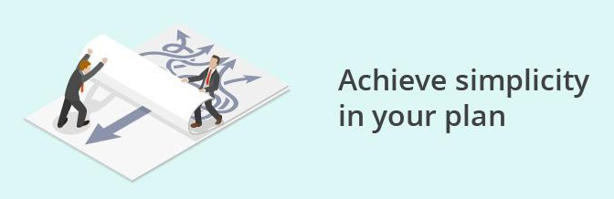
Agile Manifesto Principles
10. Keep it Simple
Simplicity – the art of maximizing the amount of work not done – is essential.
What does it mean?
This phrase might seem counterintuitive at first glance and often strikes people as odd or unnecessarily confusing, but it’s actually pretty profound. Basically, it means less is more.
Maximizing the amount of work not done calls for a mental shift from doing more to doing less. Essentially, this means that you spend more time doing only what is necessary and waste less time complicating your processes.
How to apply Agile Principle No. 10
Understand the reason and the vision for what you’re working on
Think about what is really needed. Consider a light framework, such as MoSCoW or Needs vs. Nice-to-Haves
Determine the simplest solution to the problem and consider the tradeoffs

Slide 63

Agile Manifesto Principles
11. Trust your team to self-organize
The best architectures, requirements, and designs emerge from self-organizing teams.
What does it mean?
The best work comes out of teams that are allowed to plan and execute among themselves.
Principle no. 11 is not about anarchy or some progressive operating model where people form their own clans and do whatever they want — remember, this statement was written in 2001.
The point of the 11th agile principle is that motivated and supported individuals are trusted and allowed to immerse themselves in a problem space and come up with the best solution.
Trust doesn’t just magically emerge, of course, so this advice is sometimes easier said than done.
How to apply Agile Principle No. 11
Create organizations of teams that are motivated and empowered. Train those teams on framing problems and divergent and convergent thinking
Create teams that are cross-functional to minimize dependencies
Reflect on how teams are measured and what behavior this encourages

Slide 64
Agile Manifesto Principles
12. Regular reflections on how to become more effective
At regular intervals, the team reflects on how to become more effective, then tunes and adjusts its behavior accordingly.
How to apply Agile Principle No. 12
The first mistake teams often make is running sprint retrospectives that are too predictable and too formal. Notice this agile principle makes no mention of a time frame; there’s no name or structure for this team reflection.
The second mistake (which often stems from the first) is a lack of accountability; too often, there is no follow-up or tracking of action items. I don’t believe every observation in a retrospective-like conversation needs to have an action item. However, when action items are defined, you should establish some accountability to ensure that progress is made.

Slide 65
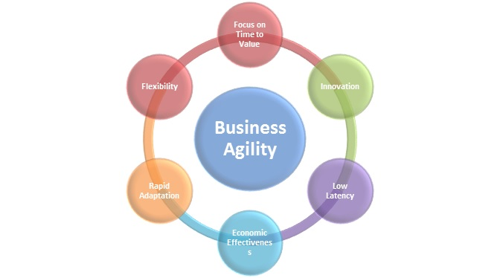
What is Business Agility?
The ability to compete and thrive in the digital age by quickly responding to market changes and emerging opportunities with innovative, digitally-enabled business solutions

Slide 66
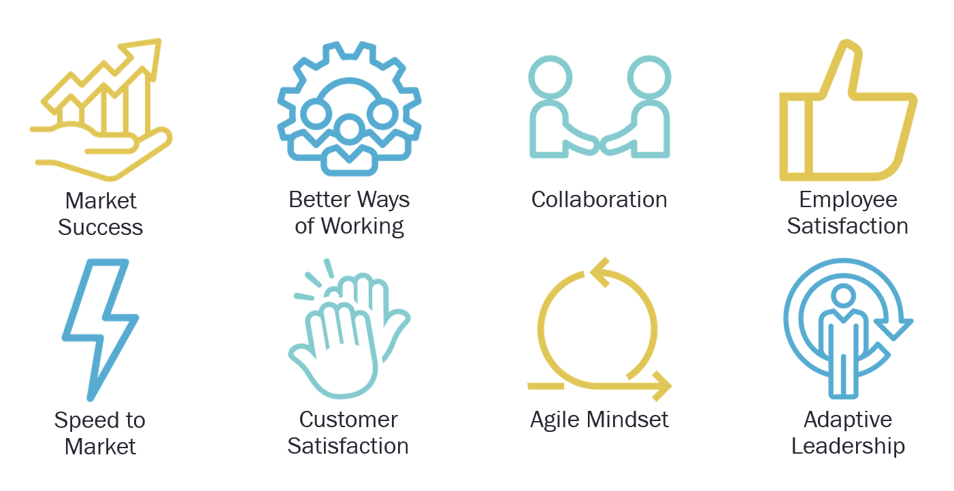
Why Business Agility?

Slide 67
Agile Frameworks
SCRUM
KANBAN
LEAN
XP or Extreme Programming
DSDM or Dynamic Systems Development Method
FDD or Feature Driven Development
Crystal

Slide 68
Agile Frameworks
Scrum:
  Iterative and incremental framework.
  Divides work into time-bound iterations called sprints (usually 1-4 weeks).
  Roles: Product Owner (defines priorities), Scrum Master (facilitates the process), Development Team (cross-functional team members).
  Ceremonies: Daily Standup, Sprint Planning, Sprint Review, Sprint Retrospective.
  Artifacts: Product Backlog (list of features), Sprint Backlog (tasks for the current sprint), Increment (working software at the end of each sprint).
Kanban:
  Visual framework focused on continuous flow.
  Work items move through a series of stages on a Kanban board.
  No fixed timeboxes (sprints); work is pulled as capacity allows.
  Emphasizes limiting work in progress (WIP) to improve focus and throughput.
  Continuous improvement is encouraged based on data and metrics.

Slide 69
Agile Frameworks
Extreme Programming (XP):
  Emphasizes technical excellence and frequent releases.
  Practices include test-driven development (TDD), pair programming, continuous integration, and refactoring.
  User stories drive development and are broken down into small tasks.
  Regular releases to production ensure rapid feedback and value delivery.
Lean Software Development:
  Based on principles from lean manufacturing.
  Focuses on maximizing customer value while minimizing waste.
  Principles include eliminating bottlenecks, delivering fast, empowering teams, and optimizing the whole process.

Slide 70
Agile Frameworks
Dynamic Systems Development Method (DSDM):
  Provides a framework for iterative development and project management.
  Emphasizes collaboration, frequent delivery, and flexibility.
  Pre-defined roles and responsibilities for team members.
  Incorporates MoSCoW prioritization (Must have, Should have, Could have, Won't have).
Crystal:
  Adaptable framework with different versions for varying project sizes and priorities.
  Emphasizes communication, reflection, and frequent delivery.
  Crystal Clear, Crystal Yellow, Crystal Orange, etc., each suited for different project types.
Feature Driven Development (FDD)
  Focuses on features.
  Short and iterative
  Emphasizes Quality
  Delivers frequent features in all the iterations
  Accurate progress information
  Famous among Client, developers, and managers

Slide 71
Key Agile Concepts
Below are a few key Agile concepts. You can see more in our glossary section.
User Stories: In consultation with the customer or product owner, the team divides up the work to be done into functional increments called “user stories.” Each user story is expected to yield a contribution to the value of the overall product. (see more)
Daily Meeting: Each day at the same time, the team meets so as to bring everyone up to date on the information that is vital for coordination: each team members briefly describes any “completed” contributions and any obstacles that stand in their way. (see more)
Personas: When the project calls for it – for instance when user experience is a major factor in project outcomes – the team crafts detailed, synthetic biographies of fictitious users of the future product: these are called “personas.” (see more)
Team: A “team” in the Agile sense is a small group of people, assigned to the same project or effort, nearly all of them on a full-time basis. A small minority of team members may be part-time contributors, or may have competing responsibilities. (see more)
Incremental Development: Nearly all Agile teams favor an incremental development strategy; in an Agile context, this means that each successive version of the product is usable, and each builds upon the previous version by adding user-visible functionality. (see more)
Iterative Development: Agile projects are iterative insofar as they intentionally allow for “repeating” software development activities, and for potentially “revisiting” the same work products. (see more)
Milestone Retrospective: Once a project has been underway for some time, or at the end of the project, all of the team’s permanent members (not just the developers) invests from one to three days in a detailed analysis of the project’s significant events. (see more)

Slide 72
Key Aspects of Agile Frameworks
Iterative Development: Agile projects are divided into smaller iterations or sprints, each typically lasting 1-4 weeks. At the end of each iteration, a potentially shippable product increment is delivered, allowing for regular feedback and adjustments.
Customer Collaboration: Continuous involvement of the customer or product owner is essential in Agile. Regular interactions and feedback help ensure that the product meets the customer's requirements and expectations.
Adaptability: Agile frameworks emphasize adaptability to changes in requirements, technology, and market conditions. Teams are encouraged to respond quickly to changes and incorporate them into the project.
Cross-Functional Teams: Agile teams are typically cross-functional, consisting of members with diverse skill sets (developers, testers, designers, etc.). This structure promotes collaboration and reduces dependency on external teams.
Continuous Delivery: Agile practices encourage delivering functional and valuable features frequently. This allows for early testing, identification of issues, and quicker adjustments.

Slide 73
Agile Frameworks
Working Software: The primary measure of progress in Agile is the working software delivered in each iteration. This contrasts with traditional methodologies that often focus on documentation or other artifacts.
Self-Organization: Agile teams are expected to be self-organizing, meaning they have the authority to make decisions about how to best achieve their goals.
Face-to-Face Communication: Agile values direct communication over written documentation. While documentation is important, face-to-face interactions help prevent misunderstandings and facilitate quicker decision-making.
Prioritization: Agile frameworks stress the importance of prioritizing tasks based on their value to the customer. This ensures that the most valuable features are developed first.
Retrospectives: Regular team retrospectives are held to reflect on what's working well and what needs improvement. This continuous improvement process helps teams refine their processes over time.

Slide 74
Any Question?
End!

